Slide 1











Document Clustering and Topic Modeling Analytics for Unstructured Data MSBA, Fall 2023 Session 8, 14th September
Dr. Anitesh Barua
David Bruton Jr. Centennial Chair Professor in Business
Distinguished Fellow, INFORMS Information Systems Society
University of Texas Distinguished Teaching Professor
McCombs School of Business, University of Texas at Austin
Email: anitesh.barua@mccombs.utexas.edu

Slide 2
Document Clustering
Useful in reducing a large number of diverse documents into groups, topics and themes.
Often uses cluster centroid to assess intra- and inter-cluster similarity
Euclidean distance or cosine similarity commonly deployed
Unsupervised method

Slide 3
An Example: Clustering Top 100 Movies Based on Synopses
Tokenize and stem/lemmatize each synopsis
Transform corpus into vector space using tf-idf
Calculate Euclidean distance or cosine similarity between each document
Cluster using k-means clustering
Use MDS and visualize with distance or similarity (not a part of clustering)
Source: http://brandonrose.org/clustering

Slide 4
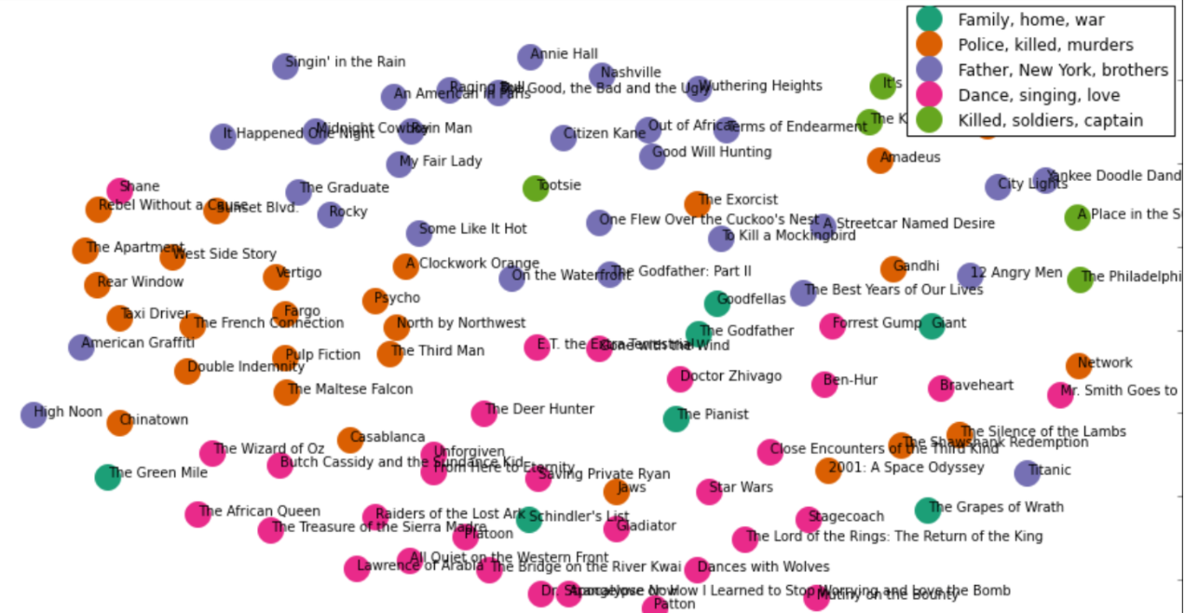
Clustering & MDS of IMDb Top 100 Movies
Source: http://harrywang.github.io/document_clustering/

Slide 5


External Evaluation of Clusters (for Classification)
Relevant when class information is available
n = number of documents
q = number of classes in data (e.g., negative, neutral, positive)
n^{i}_{r} is the number of documents of the ^{i}th class assigned to ^{r}th cluster S_{r}
n_{r} is the # documents in cluster S_{r}
_{k clusters}
Entropy of S_{r} is
Entropy of clustering is
Observations?

Slide 6


An Alternative to Entropy
Cluster purity: What % of a cluster belongs to the dominant class?
Purity of a cluster S_{r}
Purity of a clustering

Slide 7
A Different Measure
Consider searching for documents of a particular class. Clustering yields the results.
TP: Assigns two _________ docs to ______ cluster(s)
TN: Assigns two _______ docs to _______ cluster(s)
FP: Assigns two ______ docs to ______ cluster(s)
FN: Assigns two ______ docs to ______ cluster(s)
Rand Index (RI) = (TP + TN) / (TP + FP + TN + FN)
Source: https://nlp.stanford.edu/IR-book/html/htmledition/evaluation-of-clustering-1.html

Slide 8
Rand Index (RI) Calculation
Sec. 16.3
Number of document pairs | Assigned to same cluster | Assigned to different clusters
Same class in ground truth | TP | FN
Different classes in ground truth | FP | TN

Slide 9
An Example
Z Z
Z X
Z Z
Z X
X X
X Y
Z Y
Y Y
Z
Cluster I
Cluster II
Cluster III
TP = ?
FP = ?
TN = ?
FN = ?
RI = ?

Slide 10
1 Document, 1 Topic?
What are the topics in these documents?
“I like to eat broccoli and bananas.”
“I ate a banana and spinach smoothie for breakfast.”
“Chinchillas and kittens are cute.”
“My sister adopted a kitten yesterday.”
“Look at this cute hamster munching on a piece of broccoli.”
Latent Dirichlet Allocation (LDA): a way of automatically discovering topics that these sentences contain
Topics and their distributions are “latent”
Source: E. Chen

Slide 11
The Key Ideas
Topics and words
Topic A: 30% broccoli, 15% bananas, 10% breakfast, 10% munching, …
Topic B: 20% chinchillas, 20% kittens, 20% cute, 15% hamster, …
Documents and topics
Documents 1 and 2: 100% Topic A
Documents 3 and 4: 100% Topic B
Document 5: 60% Topic A, 40% Topic B
Source: E. Chen

Slide 12
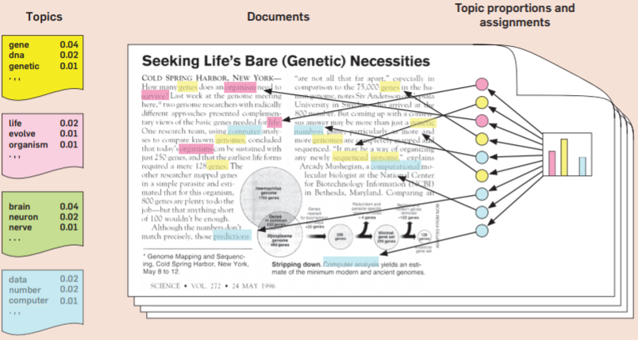
A Simple Example
Source: D. Blei

Slide 13
LDA Assumptions
LDA represents documents as mixtures of topics
Topics contain words with certain probabilities
Documents were created as follows:
For each document, the author decided on
the number of words N (e.g., according to a Poisson distribution)
a topic mixture (according to a Dirichlet distribution over a set of K topics)
E.g., a document may have 1/3 food topic and 2/3 cute animals topic
The author generated each word w_{id} in document d by:
Choosing a topic (according to a multinomial distribution)
E.g., food topic with 1/3 probability & cute animals with 2/3 probability
Generate the word itself (according to the topic’s multinomial distribution).
E.g., for the food topic, generate the word “broccoli” with 30% probability, “bananas” with 15% probability, etc.
Assuming this generative model for a collection of documents, LDA then tries to backtrack from the documents to find a set of topics that are likely to have generated the collection.
Source: E. Chen

Slide 14
Using Collapsed Gibbs Sampling
You have a set of documents.
Choose K, the number of topics to discover.
Go through each document, and use the Dirichlet distribution to assign each word in the document to one of the k topics.
Can also do the initial assignment randomly, but it won’t be LDA anymore
Source: E. Chen

Slide 15
Iterations to Reassign Topics to Words
Topic | Words in document X
Food | Fish
Food | Fish
Food | Eat
Food | Eat
Food | Veggies
Topic | Words in document Y
? | Fish
Food | Fish
Food | Milk
Pet | Kitten
Pet | Dog
For each word w in d and each topic t, calculate
p(w | t) = proportion of assignments to topic t over all documents that come from this word w.
p(t | d) = proportion of words in document d that are currently assigned to topic t
Reassign w in d a new topic t with probability: p(t | d) * p(w | t)
This is the probability that topic t generated word w in document d
Resample the current word’s topic with this probability
Assumption: All topic assignments except for the current word in question are correct
Source: E. Chen

Slide 16
Clustering Vs. Topic Modeling
A document must belong to one cluster only
Cluster described by words unique to that cluster
Important words:
politics, election, president
Important words:
illegal, terrorism, wall
Important words:
jobs, rust, outsourcing
Doc 5
Doc 8
Doc 9
Doc 1
Doc 3
Doc 2
Doc 4
Doc 6
Doc 7
Doc 10
Cluster 3
Cluster 1
Cluster 2

Slide 17
Topic Modeling
Completely different approach
May come up with the same keywords as clustering
But a document can have more than one topic
Important words:
politics, election, president
Important words:
jobs, rust, outsourcing
Important words:
illegal, terrorism, wall
Topic 1
Topic 2
Topic 3
70%
30%
Doc 1
Doc 3
Doc 2
Doc 5
Doc 4
Doc 6

Slide 18
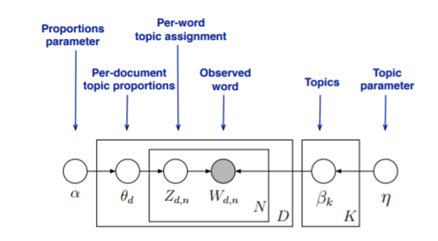
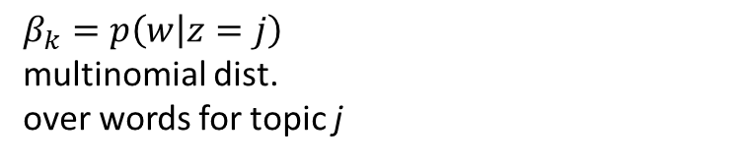

Visual Representation
$β_{k}=p\left(w | z=j\right)$
multinomial dist.
over words for topic j
Draw a topic
(Multinomial)
Topic distribution
(Dirichlet)
$p\left(θ | α\right)$
Rectangles indicate that the activities inside are repeated
Shaded circle is observed, others are latent
Source: D. Blei

Slide 19
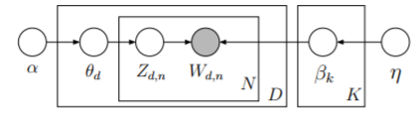

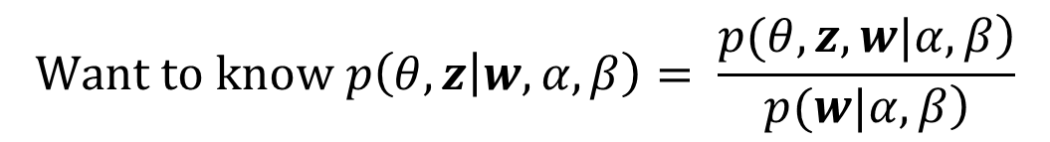
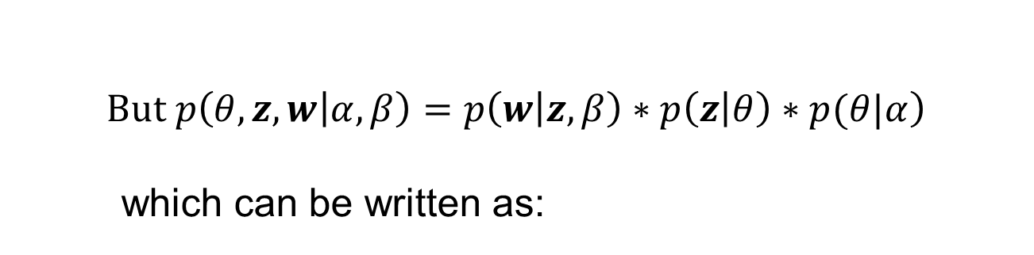
The Inference Problem
$$Want to know p\left(θ,z | w, α,β\right)= \frac{\left.p(θ,z,w|α,β\right)}{\left.p(w|α,β\right)}$$
$$\left.But p\left(θ, z, w | α,β\right)=p\left(w | z,β\right)∗p\left(z | θ\right)∗p(θ|α\right)$$
which can be written as:
Source: D. Blei

Slide 20
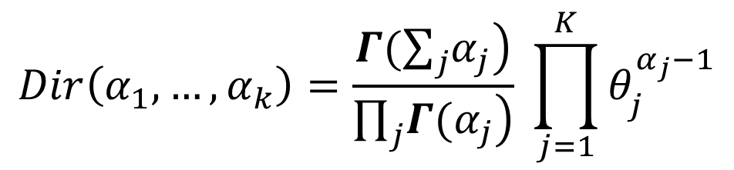
Where Does Dirichlet Come In?
Blei et al. (2003) introduced a Dirichlet prior on θ
Probability density function of a K dimensional Dirichlet
distribution over the multinomial distribution θ = (θ₁,….., θ_{k})
$$Dir\left(α_{1},…,α_{k}\right)=\frac{Γ(\sum_{j}{\left.α_{j}\right)}}{\prod_{j}{\left.Γ(α_{j}\right)}} \prod_{j=1}^{K}{θ_{j}^{α_{j}−1}}$$
Multivariate generalization of the Beta distribution
Conjugate prior of the Multinomial distribution
Used as prior distribution in Bayesian stats
Source: D. Blei

Slide 21
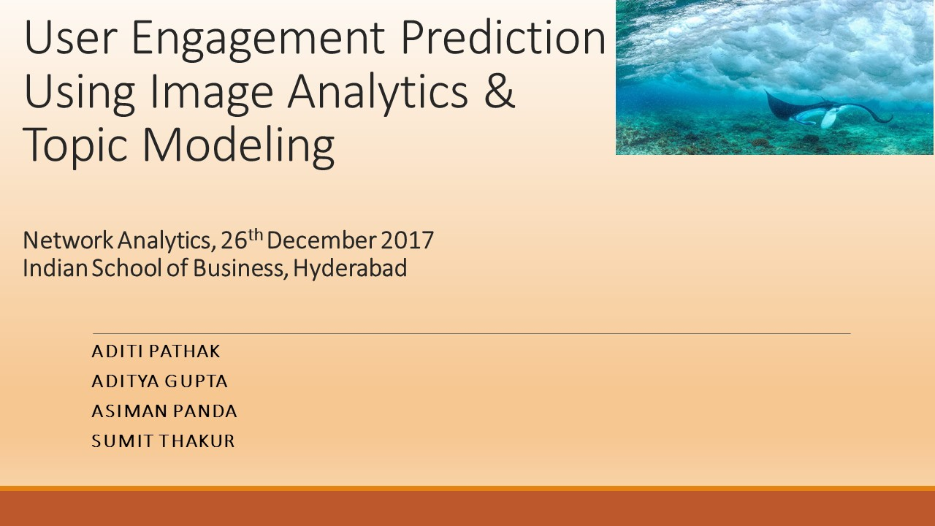
Exemplar Project 2

Slide 22
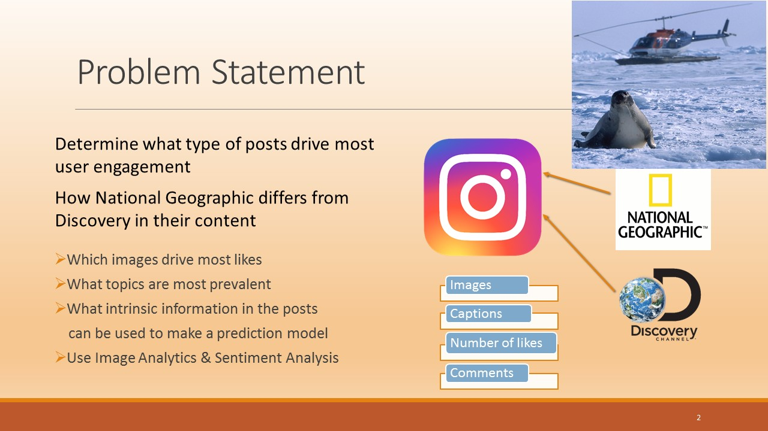

Slide 23
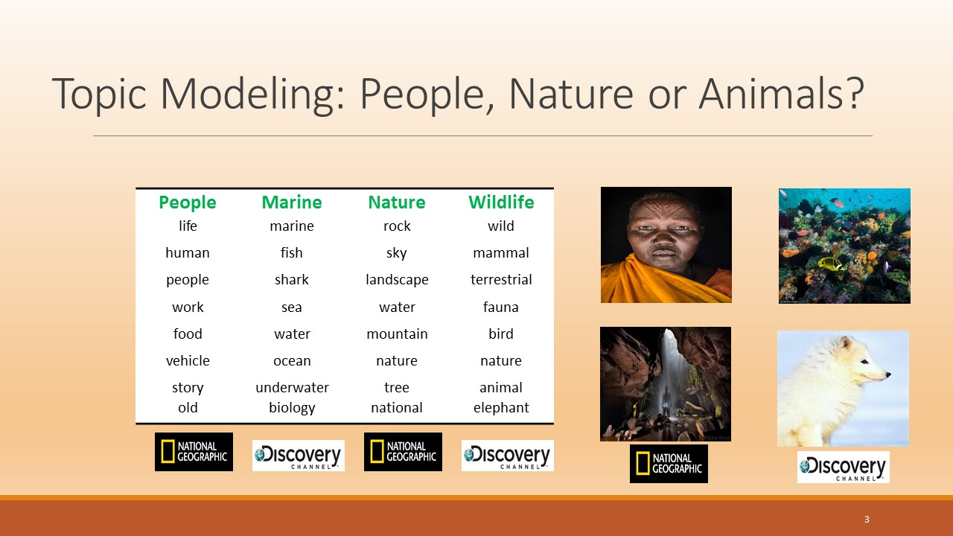

Slide 24
